Slide 1
CLUSTERING
K-Means

Slide 2
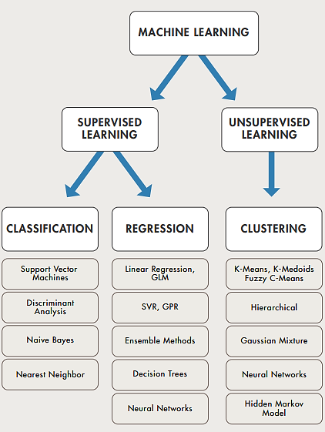
Learning

Slide 3
K-Means Clustering
K-means clustering is one of the simplest and popular unsupervised machine learning algorithms.
Typically, unsupervised algorithms make inferences from datasets using only input vectors without referring to known, or labelled, outcomes

Slide 4
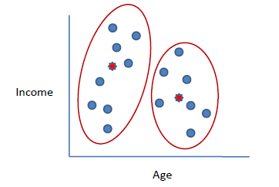
K-Means Algorithm
Clusters the data into k groups where k is predefined.
Select k points at random as cluster centers.
Assign objects to their closest cluster center according to the Euclidean distance function.
Calculate the centroid or mean of all objects in each cluster.
Repeat steps 2, 3 and 4 until the same points are assigned to each cluster in consecutive rounds.

Slide 5
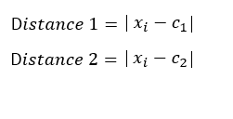
Example
Suppose we want to group the visitors to a website using just their age (one-dimensional space) as follows:
n = 19
15,15,16,19,19,20,20,21,22,28,35,40,41,42,43,44,60,61,65
Initial clusters (random centroid or average):
k = 2
c₁ = 16 c₂ = 22

Slide 6
Iteration 1: c₁ = 15.33 c₂ = 36.25
x_{i} | c₁ | c₂ | Distance 1 | Distance 2 | Nearest Cluster | New Centroid
15 | 16 | 22 | 1 | 7 | 1 | 15.33
15 | 16 | 22 | 1 | 7 | 1
16 | 16 | 22 | 0 | 6 | 1
19 | 16 | 22 | 3 | 3 | 2 | 36.25
19 | 16 | 22 | 3 | 3 | 2
20 | 16 | 22 | 4 | 2 | 2
20 | 16 | 22 | 4 | 2 | 2
21 | 16 | 22 | 5 | 1 | 2
22 | 16 | 22 | 6 | 0 | 2
28 | 16 | 22 | 12 | 6 | 2
35 | 16 | 22 | 19 | 13 | 2
40 | 16 | 22 | 24 | 18 | 2
41 | 16 | 22 | 25 | 19 | 2
42 | 16 | 22 | 26 | 20 | 2
43 | 16 | 22 | 27 | 21 | 2
44 | 16 | 22 | 28 | 22 | 2
60 | 16 | 22 | 44 | 38 | 2
61 | 16 | 22 | 45 | 39 | 2
65 | 16 | 22 | 49 | 43 | 2

Slide 7
Iteration 2: c₁ = 18.56 c₂ = 45.90
x_{i} | c₁ | c₂ | Distance 1 | Distance 2 | Nearest Cluster | New Centroid
15 | 15.33 | 36.25 | 0.33 | 21.25 | 1 | 18.56
15 | 15.33 | 36.25 | 0.33 | 21.25 | 1
16 | 15.33 | 36.25 | 0.67 | 20.25 | 1
19 | 15.33 | 36.25 | 3.67 | 17.25 | 1
19 | 15.33 | 36.25 | 3.67 | 17.25 | 1
20 | 15.33 | 36.25 | 4.67 | 16.25 | 1
20 | 15.33 | 36.25 | 4.67 | 16.25 | 1
21 | 15.33 | 36.25 | 5.67 | 15.25 | 1
22 | 15.33 | 36.25 | 6.67 | 14.25 | 1
28 | 15.33 | 36.25 | 12.67 | 8.25 | 2 | 45.9
35 | 15.33 | 36.25 | 19.67 | 1.25 | 2
40 | 15.33 | 36.25 | 24.67 | 3.75 | 2
41 | 15.33 | 36.25 | 25.67 | 4.75 | 2
42 | 15.33 | 36.25 | 26.67 | 5.75 | 2
43 | 15.33 | 36.25 | 27.67 | 6.75 | 2
44 | 15.33 | 36.25 | 28.67 | 7.75 | 2
60 | 15.33 | 36.25 | 44.67 | 23.75 | 2
61 | 15.33 | 36.25 | 45.67 | 24.75 | 2
65 | 15.33 | 36.25 | 49.67 | 28.75 | 2

Slide 8
Iteration 3: c₁ = 19.50 c₂ = 47.89
x_{i} | c₁ | c₂ | Distance 1 | Distance 2 | Nearest Cluster | New Centroid
15 | 18.56 | 45.9 | 3.56 | 30.9 | 1 | 19.50
15 | 18.56 | 45.9 | 3.56 | 30.9 | 1
16 | 18.56 | 45.9 | 2.56 | 29.9 | 1
19 | 18.56 | 45.9 | 0.44 | 26.9 | 1
19 | 18.56 | 45.9 | 0.44 | 26.9 | 1
20 | 18.56 | 45.9 | 1.44 | 25.9 | 1
20 | 18.56 | 45.9 | 1.44 | 25.9 | 1
21 | 18.56 | 45.9 | 2.44 | 24.9 | 1
22 | 18.56 | 45.9 | 3.44 | 23.9 | 1
28 | 18.56 | 45.9 | 9.44 | 17.9 | 1
35 | 18.56 | 45.9 | 16.44 | 10.9 | 2 | 47.89
40 | 18.56 | 45.9 | 21.44 | 5.9 | 2
41 | 18.56 | 45.9 | 22.44 | 4.9 | 2
42 | 18.56 | 45.9 | 23.44 | 3.9 | 2
43 | 18.56 | 45.9 | 24.44 | 2.9 | 2
44 | 18.56 | 45.9 | 25.44 | 1.9 | 2
60 | 18.56 | 45.9 | 41.44 | 14.1 | 2
61 | 18.56 | 45.9 | 42.44 | 15.1 | 2
65 | 18.56 | 45.9 | 46.44 | 19.1 | 2

Slide 9
Iteration 4: c₁ = 19.50 c₂ = 47.89
x_{i} | c₁ | c₂ | Distance 1 | Distance 2 | Nearest Cluster | New Centroid
15 | 19.5 | 47.89 | 4.50 | 32.89 | 1 | 19.50
15 | 19.5 | 47.89 | 4.50 | 32.89 | 1
16 | 19.5 | 47.89 | 3.50 | 31.89 | 1
19 | 19.5 | 47.89 | 0.50 | 28.89 | 1
19 | 19.5 | 47.89 | 0.50 | 28.89 | 1
20 | 19.5 | 47.89 | 0.50 | 27.89 | 1
20 | 19.5 | 47.89 | 0.50 | 27.89 | 1
21 | 19.5 | 47.89 | 1.50 | 26.89 | 1
22 | 19.5 | 47.89 | 2.50 | 25.89 | 1
28 | 19.5 | 47.89 | 8.50 | 19.89 | 1
35 | 19.5 | 47.89 | 15.50 | 12.89 | 2 | 47.89
40 | 19.5 | 47.89 | 20.50 | 7.89 | 2
41 | 19.5 | 47.89 | 21.50 | 6.89 | 2
42 | 19.5 | 47.89 | 22.50 | 5.89 | 2
43 | 19.5 | 47.89 | 23.50 | 4.89 | 2
44 | 19.5 | 47.89 | 24.50 | 3.89 | 2
60 | 19.5 | 47.89 | 40.50 | 12.11 | 2
61 | 19.5 | 47.89 | 41.50 | 13.11 | 2
65 | 19.5 | 47.89 | 45.50 | 17.11 | 2
No change between iterations 3 and 4 has been noted. By using clustering, 2 groups have been identified 15-28 and 35-65.

Slide 10
K-Means Clustering for 2 attributes
subject | A | B
1 | 1 | 1
2 | 1.5 | 2
3 | 3 | 4
4 | 5 | 7
5 | 3.5 | 5
6 | 4.5 | 5
7 | 3.5 | 4.5

Slide 11
Algorithm
Choose the number of clusters you want to create
As per the number of clusters, choose initial seeds to start.
Calculate distance of every value now from the initial seeds.
Now every row will be assigned to one cluster as per its minimum distance.
After one iteration, mean is calculated of each cluster and again same steps are performed until convergence.

Slide 12
First iteration
 | Seed 1 | Seed 2
1 | 0 | 7.21
2 | 1.12 | 6.10
3 | 3.61 | 3.61
4 | 7.21 | 0
5 | 4.72 | 2.5
6 | 5.32 | 2.06
7 | 4.30 | 2.92
Initial seeds had been (1,1) and (5,7)
Now using these distances calculated we will put each instance into one cluster

Slide 13
Now instance 1,2,3 will be in cluster 1 and the rest will be in cluster 2
1,2,3
4,5,6,7

Slide 14
Second iteration
Now calculate centroid of each cluster and then re calculate everything done in iteration 1.
This will be done until no change happens.
After iteration 3 you will observe that no changes will occur from iteration 2 to 3 thereby we stop.
In iteration 2 instance 3 will move to cluster 2.

